Slide 1
Hibernate - Basic
September 1, 2016

Slide 2
JDBC Overview
Pros and Cons of JDBC
ORM Overview
Advantage of ORM
Hibernate Overview
Hibernate Architecture
Hibernate Configuration
Crud Operations
Hibernate components
Configuration
Session Factory
Session
Transaction
JPA Introduction
ORM Challenges
Persistence Lifecycle
Object Equality
Different Inheritance Mapping
HQL/JPA QL

Slide 3
Objectives
Learning basic hibernate topics including-
Overview
Hibernate Architecture
Hibernate Configuration
Crud Operations
Hibernate components
Persistence Lifecycle
Object Equality
Different Inheritance Mapping
HQL/JPA QL

Slide 4
Overview

Slide 5
JDBC Overview
Java Database Connectivity (JDBC) is a specification that defines a consistent mechanism to connect a java application with a database.
JDBC API provides a set of interfaces and classes like Connection, Statement etc. in order to define the specification.
Different database vendor implements JDBC specification in order to support java database connectivity.
By importing database vendor specification API in our class path, we can use standard JDBC Interfaces to in our code to interact with the database.
Pros of JDBC
Establishing a connection with the database.
Clean and simple SQL processing
Query and update the database.
Process the result.
Very good for small applications

Slide 6
Cons of JDBC
Different database vendor use different SQL statements (DDL, DML etc.). A Java programmer needs to work with database vendor specific SQL statements.
JAVA programmer has to work on individual columns of each row.
JAVA programmers has to fetch the database entities and initialize an object programmatically.
Difficult to map Relational concepts to Object Oriented Concepts.
Persisting object graph to relational model is an overhead
Querying the object graph is cumbersome.
Large number of classes (More Exercise on design, transaction Management etc)
Complex if it is used in large projects
Repetitive and complicated code.
As an object-oriented programmer, you would not like to take overhead of dealing with SQL.
No caching technique, no lazy fetching.

Slide 7
ORM Overview
In a nutshell, Object/Relational Mapping is the automated (and transparent) persistence of objects in a Java application to the tables in a relational database, using metadata that describes the mapping between the objects and the database.
This creates, in effect, a "virtual object database" that can be used from within the programming language.
A JAVA programmer works with JAVA objects instead-of writing complex vendor specific SQL statements in JAVA code.
A table is mapped to a JAVA class and this mapping is done in configuration files.
Advantages of ORM:
An API for performing basic CRUD operations on objects of persistent classes
A language or API for specifying queries that refer to classes and properties of classes
A facility for specifying mapping metadata
A technique for the ORM implementation to interact with transactional objects to perform dirty checking, lazy association fetching, and other optimization functions.

Slide 8
Hibernate Introduction

Slide 9
Hibernate
Object relational mapping library for java language.
Provides a framework for mapping an object-oriented domain object to relational databases.
Is an open source software.
Current version of hibernate is 5.x.
Notes:
Reference:
http://docstore.mik.ua/orelly/java-ent/jnut/ch01_02.htm

Slide 10
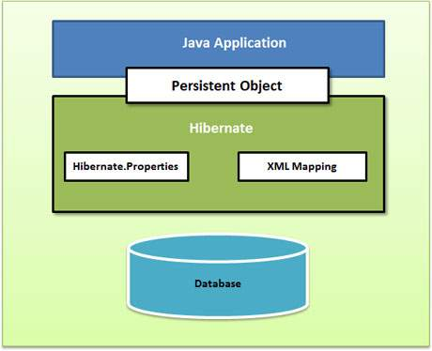
Hibernate Overview
Hibernate is an open source, lightweight, ORM (Object Relational Mapping) tool. Hibernate sits between traditional Java objects and database server to handle all the work in persisting those objects based on the appropriate O/R mechanisms and patterns.
Hibernate Architecture
The Hibernate architecture is layered to keep you isolated from having to know the underlying APIs. Hibernate makes use of the database and configuration data to provide persistence services (and persistent objects) to the application.
Following is a very high level view of the Hibernate Application Architecture.

Slide 11
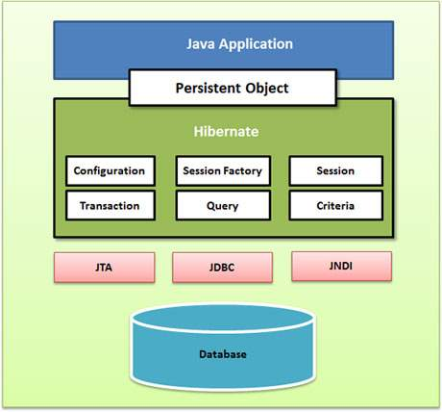
Following is a detailed view of the Hibernate Application Architecture with few important core classes.
Hibernate uses various existing Java APIs, like JDBC, Java Transaction API(JTA), and Java Naming and Directory Interface (JNDI). JDBC provides a rudimentary level of abstraction of functionality common to relational databases, allowing almost any database with a JDBC driver to be supported by Hibernate. JNDI and JTA allow Hibernate to be integrated with J2EE application servers.

Slide 12
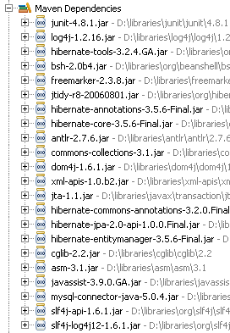
Lets Do it now… analyze later… We will start with an example of hibernate without having knowledge of it. We will analyze it later as it is going to help us in basics.
Add hibernate libraries-
You need to add hibernate library jar files and its supported jar files in the class path.
Either You can download the hibernate distribution from the J-Boss site or you can setup a maven project to resolve dependencies.
Vendor specific JDBC jar file is also required.

Slide 13
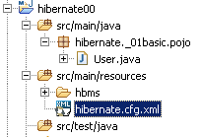
Add hibernate.cfg.xml to class path
The Hibernate configuration file (either hibernate.cfg.xml or hibernate.properties file) has to be created in the class path, it is used by the hibernate API to fetch database details and other mapping information.
If both hibernate.cfg.xml and hibernate.properties are there in the class path, hibernate.cfg.xml is read by the hibernate API.
If you are not happy with default configuration architecture, you can set the configuration programmatically.

Slide 14
Hibernate Configuration
Hibernate requires to know in advance — where to find the mapping information that defines how your Java classes relate to the database tables. Hibernate also requires a set of configuration settings related to database and other related parameters. All such information is usually supplied as a standard Java properties file called hibernate.properties, or as an XML file named hibernate.cfg.xml.
Following is the list of important properties you would require to configure for a databases in a standalone situation:
hibernate.dialect - This property makes Hibernate generate the appropriate SQL for the chosen database.
hibernate.connection.driver_class - The JDBC driver class.
hibernate.connection.url - The JDBC URL to the database instance.
hibernate.connection.username - The database username.
hibernate.connection.password - The database password.
hibernate.connection.pool_size - Limits the number of connections waiting in the Hibernate database connection pool.
hibernate.connection.autocommit - Allows autocommit mode to be used for the JDBC connection.

Slide 15
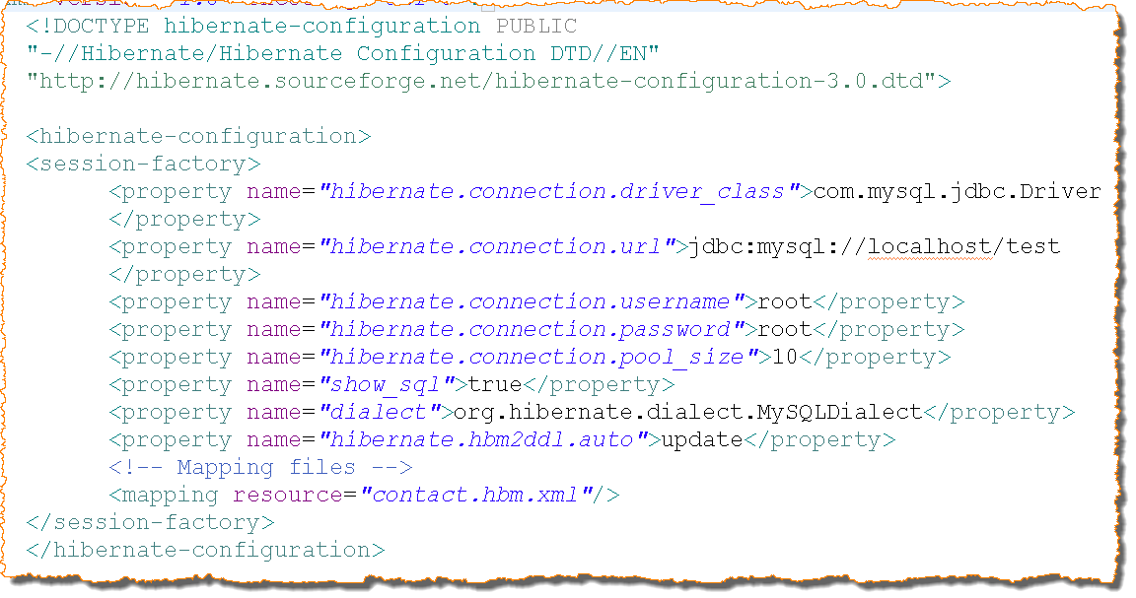
Hibernate Configuration File
Database driver name
Database url
Connection pool size
User name
Password
SQL dialect
Mapping files name

Slide 16
hibernate.hbm2ddl.auto
Automatically validates or exports schema DDL to the database when the SessionFactory is created. With create-drop, the database schema will be dropped when the SessionFactory is closed explicitly.
e.g. validate | update | create | create-drop
So the list of possible options are,
validate: validate the schema, makes no changes to the database.
update: update the schema.
create: creates the schema, destroying previous data.
create-drop: drop the schema at the end of the session.

Slide 17
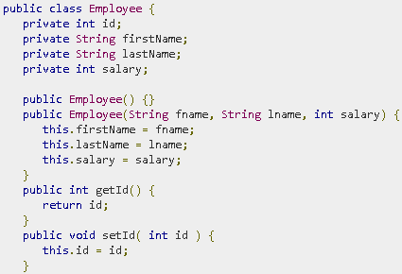
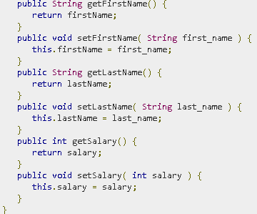
Persisting Object– CRUD Operations
The entire concept of Hibernate is to take the values from Java class attributes and persist them to a database table. A mapping document helps Hibernate in determining how to pull the values from the classes and map them with table and associated fields.
Java classes whose objects or instances will be stored in database tables are called persistent classes in Hibernate. Hibernate works best if these classes follow some simple rules, also known as the Plain Old Java Object (POJO) programming model.
Step 1: Create POJO Class

Slide 18
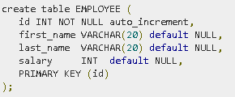
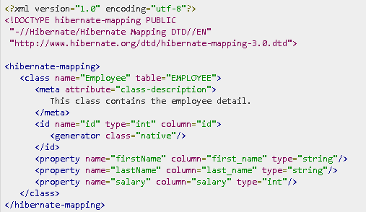
Step 2: Create Database
Step 3: Create Mapping Configuration File

Slide 19
You should save the mapping document in a file with the format .hbm.xml. We saved our mapping document in the file Employee.hbm.xml. Let us see little detail about the mapping document:
The mapping document is an XML document having as the root element, which contains all the <class> elements.
The <class> elements are used to define specific mappings from a Java classes to the database tables. The Java class name is specified using the name attribute of the class element and the database table name is specified using the table attribute.
The <meta> element is optional element and can be used to create the class description.
The <id> element maps the unique ID attribute in class to the primary key of the database table. The name attribute of the id element refers to the property in the class and the column attribute refers to the column in the database table. The type attribute holds the hibernate mapping type, this mapping types will convert from Java to SQL data type.
The <generator> element within the id element is used to generate the primary key values automatically. The class attribute of the generator element is set to native to let hibernate pick up either identity, sequence, or hilo algorithm to create primary key depending upon the capabilities of the underlying database.

Slide 20
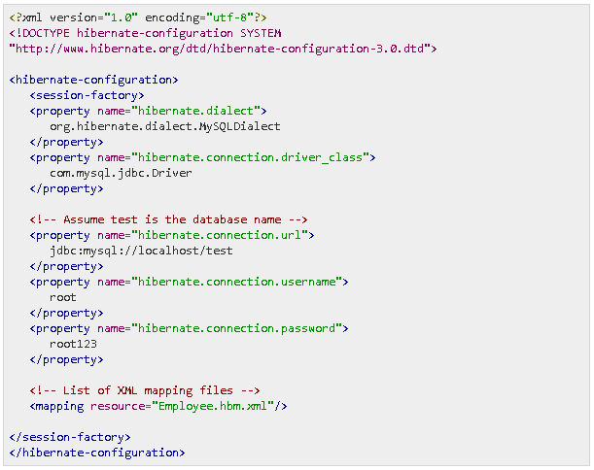
The <property> element is used to map a Java class property to a column in the database table. The name attribute of the element refers to the property in the class and the column attribute refers to the column in the database table. The type attribute holds the hibernate mapping type, this mapping types will convert from Java to SQL data type.
Step 4: Add .hbm file entry to configuration file

Slide 21
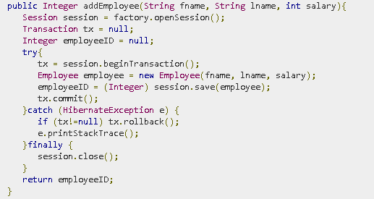
Step 5: Create Application Class
/* Method to CREATE an employee in the database */

Slide 22
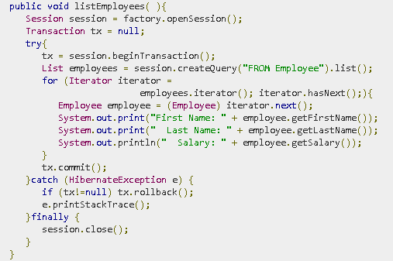
/* Method to READ all the employees */

Slide 23
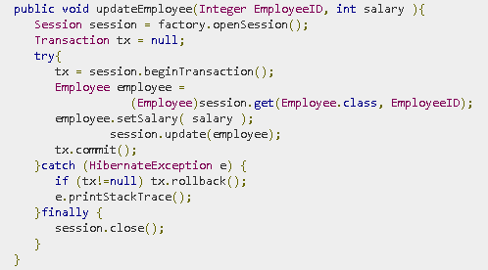
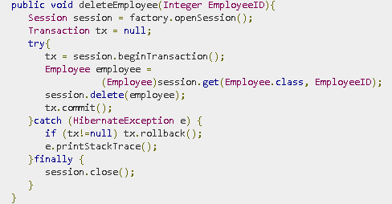
/* Method to UPDATE salary for an employee */
/* Method to DELETE an employee from the records */

Slide 24
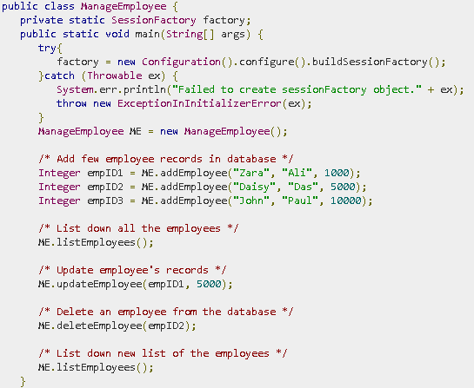
/* Main Method -*/

Slide 25
Compilation and Execution
Create hibernate.cfg.xml configuration file as explained in configuration.
Create Employee.hbm.xml mapping file as shown above.
Create Employee.java source file as shown above and compile it.
Create ManageEmployee.java source file as shown above and compile it.
Execute ManageEmployee binary to run the program.

Slide 26
Get vs Load
session.get()
It always hit the database and return the real object, an object that represent the database row, not proxy.
If no row found , it return null.
session.load()
It will always return a “proxy” (Hibernate term) without hitting the database. In Hibernate, proxy is an object with the given identifier value, its properties are not initialized yet, it just look like a temporary fake object.
If no row found , it will throws an ObjectNotFoundException.
For details:
http://www.journaldev.com/3472/hibernate-session-get-vs-load-difference-with-examples

Slide 27
Merge vs Update
Update - should be used to save the data when the session does not contain an already persistent instance with the same identifier. Merge - should be used to save the modifications at any time without knowing about the state of a session.
For details:
http://www.java4s.com/hibernate/difference-between-merge-and-update-methods-in-hibernate/

Slide 28
Save vs persist
First difference between save and persist is there return type. Similar to save method persist also INSERT records into database but return type of persist is void while return type of save is Serializable object.
2) One more thing which differentiate persist and save method in Hibernate is that is there behavior on outside of transaction boundaries. persist() method guarantees that it will not execute an INSERT statement if it is called outside of transaction boundaries. save() method does not guarantee the same, it returns an identifier, and if an INSERT has to be executed to get the identifier (e.g. "identity" generator), this INSERT happens immediately, no matter if you are inside or outside of a transaction.
3) Fourth difference between save and persist method in Hibernate is related to previous difference on save vs persist. Because of its above behavior of persist method outside transaction boundary, its useful in long-running conversations with an extended Session context. On the other hand save method is not good in a long-running conversation with an extended Session context.
Read more: http://javarevisited.blogspot.com/2012/09/difference-hibernate-save-vs-persist-and-saveOrUpdate.html#ixzz4K2G0WtZJ

Slide 29
Hibernate Components

Slide 30



Configuration
Hibernate uses the Configuration object to read configuration files and store it in memory for further use.
The application uses a Configuration instance to specify the location of mapping documents and Hibernate-specific properties and then create the SessionFactory.
You can also configure your hibernate application programmatically as follows:

Slide 31
Session Factory
The application obtains Session instances from a SessionFactory.
Typically, a session factory is shared among many application threads. There is typically a single SessionFactory for the whole application.
If your application needs to work with more than one database than you will have to work with two different session factories.

Slide 32
Session
Represents a conversation between java application and database.
It’s a Non-thread safe object. Your design should share one session interface in one thread only.
Each session can have zero or more data-base transactions.
Provides interface to perform CRUD operations on database.
Important Methods of Session
Return Type | Method
Object | Load (Class cls, Serializable id)
Serializable | Save (Object obj)
void | Update (Object obj)
void | flush()
Transaction | beginTransaction ()
Connection | close()
void | Delete (Object obj)

Slide 33
Session
Database CRUD operations are performed by using a session object.
The Hibernate notion of a session is something between connection and transaction. It may be easier to think of a session as a cache or collection of loaded objects relating to a single unit of work.
There can never be conflicting representations of the same database row at the end of a unit of work. In the persistence context, at most a single object represents any database row.
If a database entity is loaded more than once in a session, JVM would return the same POJO everytime. It means, a persistent object (equivalent to a row/entity in the database) is unique within a session at JVM level.
Important Points:
To check if session contain any changes which must be synchronized with the database, sessions isDirty() method can be used. It will tell, would any DML operations be executed if we flushed this session?

Slide 34
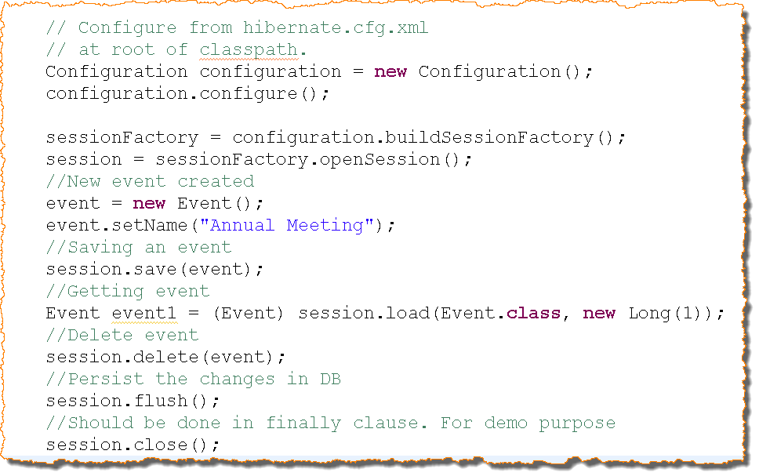
Session (Contd..)

Slide 35
Session Factory vs Session
Session Factory is Thread Safe: that is many threads can access it concurrently and request for sessions. It holds cached data that has been read in one unit of work and may be reused in a future unit of work. Good practice is to create it when the application is initialized. SessionFactory is Hibernate’s concept of a single datastore and is threadsafe so that many threads can access it concurrently and request for sessions and immutable cache of compiled mappings for a single database. A SessionFactory is usually only built once at startup. SessionFactory should be wrapped in some kind of singleton so that it can be easily accessed in an application code.
Session is not Thread Safe. A Session is a light weight and a non-threadsafe object (No, you cannot share it between threads) that represents a single unit-of-work with the database. Sessions are opened by a SessionFactory and then are closed when all work is complete. Session is the primary interface for the persistence service. A session obtains a database connection lazily (i.e. only when required). To avoid creating too many sessions, ThreadLocal class can be used as shown below to get the current session no matter how many times you make call to the currentSession() method.

Slide 36
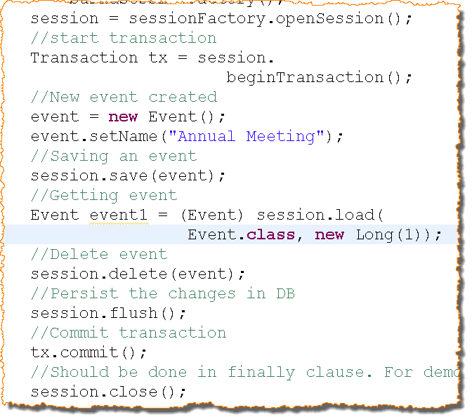
Transaction
Group of operations that constitutes single unit of work
Operations under a transaction are atomic
Transactions are associated with hibernate session
A hibernate session can have multiple transactions.
When using commit() method on a transaction object, explicit call to flush is not required, as commit automatically flushes session.

Slide 37
Exercise
Create a database BookStoreDB. Create a simple java project named BookStoreApp. Add hibernate and MySQL libraries to the project
Create hibernate.cfg.xml file and configure it
Create a POJO - Book with fields ISBN number, book title and publication date
Create a mapping file named Book.hbm.xml and map the properties to the table column
Create a java class BookStoreApp. Inside main method, add books to the database and verify that they get added to the database.

Slide 38
Different style of configuration
For Hibernate 2.x, we use hibernate configuration XML configuration files to configure environment properties. We map persistence objects with persistence schema in different mapping files.
With the release of JAVA 5, came the concept of annotations. Annotations have become popular as an alternative for the XML configuration. Hibernate 3.x API has support for hibernate annotations.
Different annotations can be used in a persistence POJO class to map it with an database entity.
You use either use XML or annotations for mapping. Using XML or annotation is a matter of individual choice.

Slide 39
JPA Introduction

Slide 40
Introduction to JPA
Hibernate, Top-Link etc. became popular as an ORM solution. Due to the popularity of different ORM frameworks, SUN (now Oracle) decided to publish a specification for the ORM.
Java Persistence API (JPA) is the specification for ORM applications provided by SUN. It has a set of interfaces in javax.persistence package. A provider of JPA needs to support JPA specifications and also provide implementation of JPA interfaces.

Slide 41
Lets do it using JPA
We will start with an example of hibernate with JPA and learn the concepts later. We will analyze it later as it is going to help us in basics. To start with, We have the following problem statement.
Save a user object to the database table PERSON.
Column Name | Description
ID | DB Generated key
PERSON_NAME | NOT NULL
DESCRIPTION | NOT NULL

Slide 42
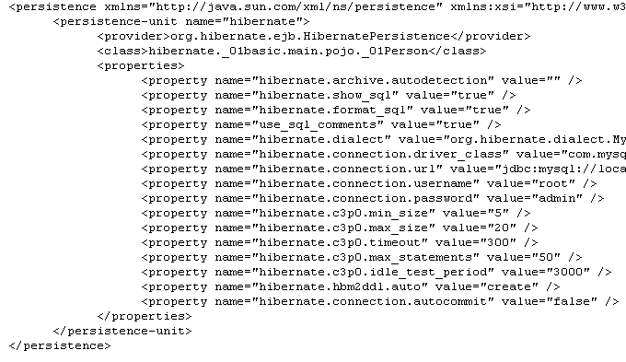
Step 1: Create META-INF/persistence.xml
We need to put environment specific configuration in META-INF/persistence.xml.
META-INF folder should be created in the class path.
Database driver name
Database url
Connection pool size
User name
Persistence unit
Password
SQL dialect
Mapping POJO
Class

Slide 43
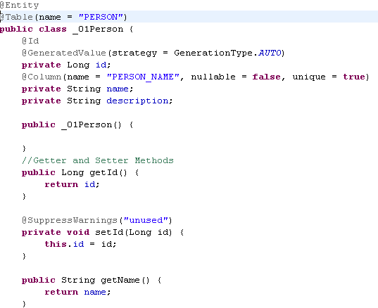
Step 2: Create annotated pojo
Table Mapping
This pojo is an entity
ID Mapping
Auto Generation
Column Mapping

Slide 44
Step 3: Map POJO class in persistence.xml
We need map the pojo class in persistence unit.
If you set the property ‘hibernate.archive.autodetection’ to ‘class’, all the pojo classes will be detected automatically (No need to provide pojo class mapping).
Mapping POJO
Class

Slide 45
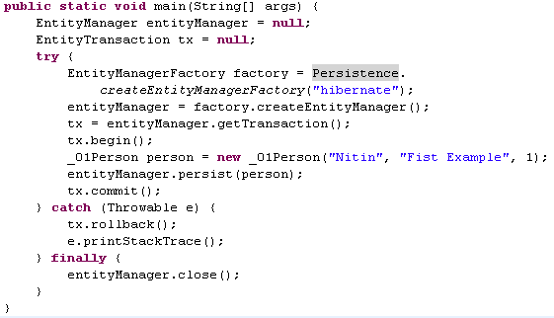
Step 4: Client Application
Persistence Unit
Create entity manager
Start Transaction
Persist the pojo
Commit Transaction
Close entity Manager

Slide 46
Persistence.xml
A JPA application expects persistence.xml file in META-INF folder. This file is used to define environment properties. This file is the equivalent of hibernate.cfg.xml.
We define at least one persistence unit in persistence.xml. A persistence unit represents one environment.
We need to define persistence provider to define the underlying ORM API.
<provider>org.hibernate.ejb.HibernatePersistence</provider>
We map POJO classes in the persistence.xml.

Slide 47
Annotated POJO
@javax.persistence.Entity - We use this to define class as an entity. We define class level annotation on the POJO class to map a POJO with a database table.
@Table - By default, table name is taken as the class name. If you want to provide a different table name, you need to put this annotation on the POJO class.
@javax.persistence.Id - Database identity(primary key) can be defined on a POJO property by using this annotation.
@javax.persistence.GeneratedValue - If "Id" is an auto generated value, we use this annotation for defining an auto generation strategy.
@javax.persistence.Column - Every property of the POJO maps to a column in the mapped table. By default, name of the column is same to the name of the property. If you want to have a different column name, you have to map the POJO property with the column name by using this annotation.
Similar to the hibernate, we choose to use either annotated configuration or xml configuration. If you want to use XML configuration in JPA environment, you need to place orm.xml file in the META-INF folder.

Slide 48
Annotated POJO Cont…
You can define your annotations either on the properties or on the setter methods. If you have defined @Id annotation on the property, you will have to define all other column level annotations on properties.
If ID is auto generated, its setter method should be private.
We must add a no argument constructor to the POJO class. When an entity is loaded from the database, no argument constructor is called by the hibernate API.
JPA vendor also provide some additional functionalities (not supported by JPA) by providing their own annotations. We can use vendor specific annotations along with JPA annotations.

Slide 49
JPA Client interfaces
javax.persistence.Persistence—A startup class that provides a static method for the creation of an EntityManagerFactory.
javax.persistence.EntityManagerFactory—The equivalent to a Hibernate SessionFactory. This runtime object represents a particular persistence unit. It’s thread-safe, is usually handled as a singleton, and provides methods for the creation of EntityManager instances.
javax.persistence.EntityManager—The equivalent to a Hibernate Session. This single-threaded, nonshared object represents a particular unit of work for data access. It provides methods to manage the lifecycle of entity instances and to create Query instances.
javax.persistence.EntityTransaction—This is the equivalent to a Hibernate Transaction, used in Java SE environments for the demarcation of RESOURCE_LOCAL transactions. In Java EE, you rely on the standardized javax.transaction.UserTransaction interface of JTA for programmatic transaction demarcation.

Slide 50
Exercise
Create a database BookStoreDB. Create a simple java project named BookStoreApp. Add hibernate and MySQL libraries to the project
Create persistence.xml file and configure it
Create a POJO Book with fields ISBN number, book title and publication date
Create a mapping POJO and map the properties to the table column
Create a java class BookStoreApp. Inside main method, add books to the database and verify it

Slide 51
ORM Challenges

Slide 52
Database primary Key
Primary key for a table is a set of columns which can uniquely identify a row of the table. At database level, we can define primary key of a table in below two different ways:
Natural Primary Key – A natural key is a key with business meaning: an attribute or combination of attributes that is unique by virtue of its business semantics.
Surrogate Key – Surrogate keys have no business meaning— they are unique values generated by the database or application.
In ORM tool, different states of a POJO (transient, persistent or detached) can be managed by the primary key.
Primary key is responsible to uniquely identify a persistent object in a session. For the ORM tools perspective, value of a primary key should not be changed.

Slide 53
Selection of primary Key
If you are planning to switch your legacy application (have existing database with natural primary keys) to hibernate application, you will have to work with natural keys. Also you will define your configuration according to the existing database.
But if you are planning to use hibernate in a new application then you should not work with natural keys. Below are the problems with natural keys:
If a natural key is changed in a table, all reference tables also must be altered.
If the value of primary key is changed, ORM tool have to work more to distinguish different POJO states
Natural keys aren’t efficiently indexable by SQL databases.
For these reasons, we strongly recommend that new applications use synthetic identifiers (also called surrogate keys).
There are different primary key generation strategies supported by different database.

Slide 54

Auto Generated values
For surrogate keys we prefer to use Auto generated values.
Marking a field with the @GeneratedValue annotation specifies that a value will be automatically generated for that field. Hibernate supports different value generation strategies -
The Auto Strategy
ObjectDB maintains a special global number generator for every database. This number generator is used to generate automatic object IDs for entity objects with no primary key fields defined.
The same number generator is also used to generate numeric values for primary key fields annotated by @GeneratedValue with the AUTO strategy:

Slide 55


AUTO is the default strategy, so the following definition is equivalent:
During a commit the AUTO strategy uses the global number generator to generate a primary key for every new entity object. These generated values are unique at the database level and are never recycled.
The Identity Strategy
The IDENTITY strategy is very similar to the AUTO strategy. The IDENTITY strategy also generates an automatic value during commit for every new entity object. The difference is that a separate identity generator is managed per type hierarchy, so generated values are unique only per type hierarchy.

Slide 56
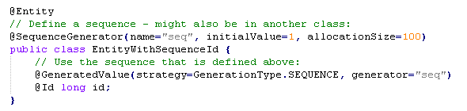
The Sequence Strategy
The sequence strategy consists of two parts - defining a named sequence and using the named sequence in one or more fields in one or more classes. The @SequenceGenerator annotation is used to define a sequence and accepts a name, an initial value (the default is 1) and an allocation size (the default is 50). A sequence is global to the application and can be used by one or more fields in one or more classes. The SEQUENCE strategy is used in the @GeneratedValue annotation to attach the given field to the previously defined named sequence:
Unlike AUTO and IDENTITY, the SEQUENCE strategy generates an automatic value as soon as a new entity object is persisted (i.e. before commit). This may be useful when the primary key value is needed earlier. To minimize round trips to the database server, IDs are allocated in groups. The number of IDs in each allocation is specified by the allocationSize attribute. It is possible that some of the IDs in a given allocation will not be used. Therefore, this strategy does not guarantee there will be no gaps in sequence values.

Slide 57
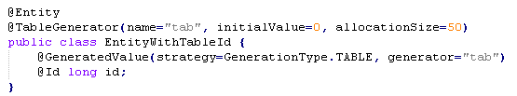
The Table Strategy
The TABLE strategy is very similar to the SEQUENCE strategy:
A tiny difference is related to the initial value attribute. Whereas the SEQUENCE strategy maintains the next sequence number to be used the TABLE strategy maintains the last value that was used. The implication for the initialValue attribute is that if you want sequence numbers to start with 1 in the TABLE strategy initialValue=0 has to be specified in the @SequenceGenerator annotation.

Slide 58

Dynamic SQL generation
By default, Hibernate creates SQL CRUD statements for each persistent class on startup. In the default insert and update statement, all the columns of a table are inserted and updated.
We can configure dynamic creation of insert and update statement. For insert statement, null properties are not inserted as a part of insert statement. For update statement, if a property has not been changed, that will not take part in the update statement.

Slide 59

Immutable Entity
Instances of a particular class may be immutable. For example, in an online auction application, a Bid made for an item is immutable. Hence, no UPDATE statement ever needs to be executed on the BID table. We can configure our entity immutable.
A POJO is immutable if no public setter methods for any properties of the class are exposed—all values are set in the constructor. But, if an immutable entity has public setter methods, then also update statements are not executed.

Slide 60
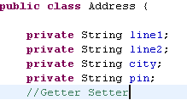

Composite Properties
Let us suppose that we have address related fields in the employee table but we want to map those columns to the properties of Address class.
Also an employee can have local address and permanent address.
ID | NAME | L_ADDRESS1 | L_ADDRESS2 | L_CITY | L_PIN

Slide 61
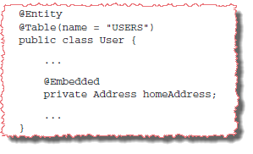
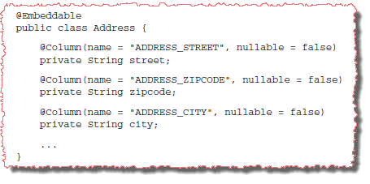
JPA Embedded Property
Composite properties in Java Persistence specification are known as embedded classes. For a composite property, you can declare a particular property in the owning entity class as @Embedded.
If you don’t declare a property as @Embedded, and it isn’t of a pre-defined JDK type, Hibernate looks into the associated class for the @Embeddable annotation.

Slide 62
Embedded Property mapping
If you have define only one composite address (local address) property in the employee POJO, mapping defined in Address POJO will work.
What would happen if your Employee POJO has two addresses – Local and Permanent Address? We can not map two different properties to a single database column i.e. local address city and permanent address city can not be mapped to the EMPLOYEE_ADDRESS table column.

Slide 63
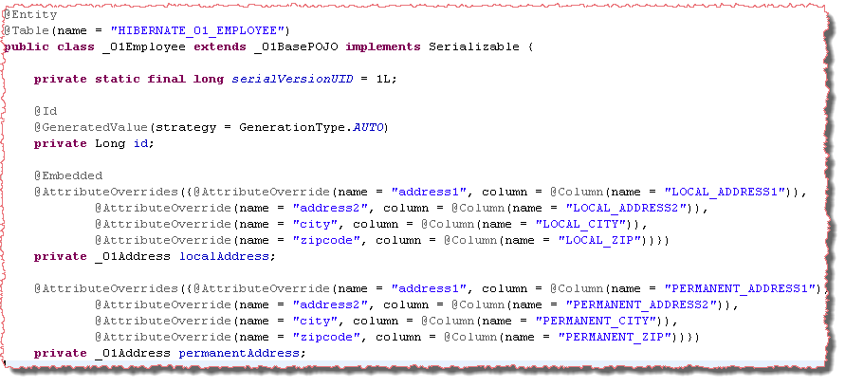
More than one embedded property
If your Employee POJO has two addresses – Local and Permanent Address, we need to override the attributes mapping of embeddable Address class.

Slide 64
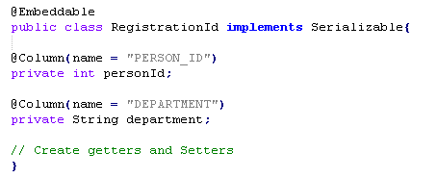
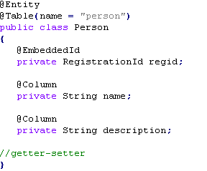
Composite Key
If the table has a primary key then in Entity class we configure that column using @Id annotation. Even when the table doesn’t need a primary key, we must configure one column as id (one primary key is must). Now If the database table has more than one column as primary key then we call it as composite primary key, so if the table has multiple primary key columns , then in order to configure these primary key columns we need to create a new @Embeddable class containing the PK fields:

Slide 65
Persistence Lifecycle

Slide 66
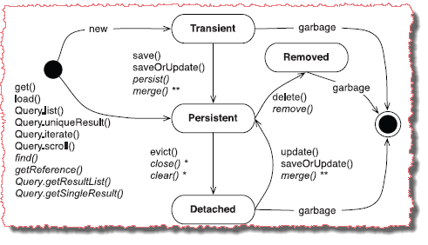
Persistence Lifecycle
Refers to the states an object goes through during its life
Objects can have one of the four states
Transient object
Persistent or managed object
Removed object
Detached object

Slide 67
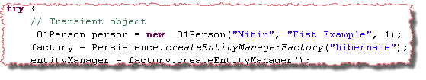
Transient Object
Object created using new operator that has not been saved in the database
These objects does not map to a row in database
These Objects are not associated with hibernate session
State of such objects is lost if no object is referencing them
Objects that are referenced by only other transient objects are also transient object

Slide 68
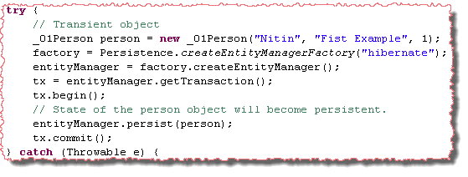
Persistent Object
An object with database identity
Objects persisted in the database by calling one of the methods like save etc.
Maps to a row in database
Is retrieved from database by execution of a query
Is retrieved from another persistence object

Slide 69
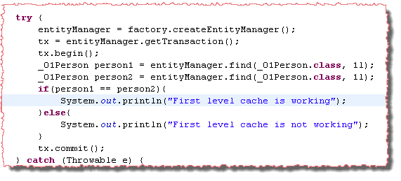
Persistent Object Cont…
A persistent object is associated with persistence context and its modification is cached in the persistence context.
A persistent object is unique in its persistence context. If you fetch a database entity twice in the persistence context, you will have the same object in both requests.
Select Query is fired for the first time access. Object is returned from the cache in consequent requests.
If statement is executed

Slide 70
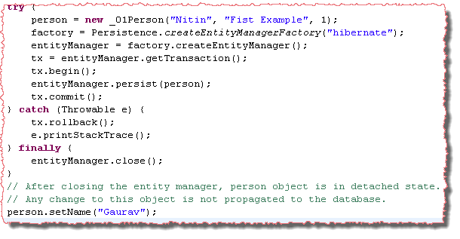
Detached Object
A detached object is associated with database identity but it is not attached with any persistence context.
Any change to the state of detached object is not synchronized with database
Detached objects can be re attached to same or another persistence context
When a persistence context is closed, all attached persistent objects become detached.
Changes will not be persisted

Slide 71
Removed Object
Is an object scheduled for deletion from database.
A row in the database corresponding to this object will be deleted.
Should not be used after a transaction is committed.
It may be present in JVM but there is no row corresponding to it in the database.

Slide 72
Persistent to Detached
When a persistence context is closed, all the persisted objects attached to the persistence context become detached.
If you want to detach a single persistent object without closing the persistence context, you can either call JPA entity manager's detach(Object pojo) method or you can call hibernate session's evict(Object pojo) method.

Slide 73
Detached to Persistent
A call to JPA EntityManager.merge(Object pojo) or Hibernate Session.update(Object pojo) will make the detached object, persistent once again.
A call to lock() associates the object with the Session and its persistence context without forcing an update. Changes made before the call to lock() aren’t propagated to the database, you use it only if you’re sure the detached instance hasn’t been modified.
You can merge a detached object in a session.
You can directly remove an entity by passing detached object to delete() method.

Slide 74
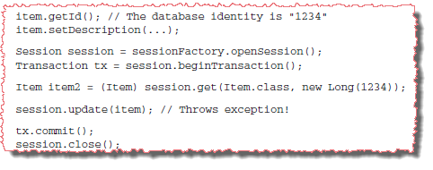
Re-attachment of duplicate detached object
What will happen if we re-attach a detached object (id=1) to a persistence context in which we have already loaded the same persistent entity(id=1)? At persistence context, a persistent object is unique in the JVM.
The error message of the exception is A persistent instance with the same database identifier is already associated with the Session! Hibernate can’t decide which object represents the current state.
To overcome this scenario, hibernate added a method merge to the persistence context.

Slide 75
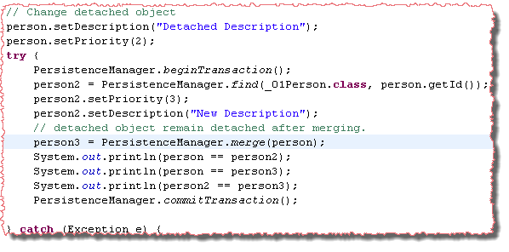
Merging a Detached object.
Merging of a detached object is an alternative approach. It can be complementary to or can replace reattachment.
Later change is propagated to the database. If detached object is merged after all changes in the duplicate persistent object, changes of detached object will be propagated
Change Persistence property of a detached object
Load Object with the same ID
Merge Detached Object
false
false
true

Slide 76
Exercise
Create a POJO Author, with fields - id, work category, firstName, lastName, nationality, dob and address.
Inside BookStoreApp class create a method persistAuthor(). Create an instance of author , set its properties except address and persist it in database. Close the entity manager.
Set the address of the detached object. Merge the detached object and close the entity manager.

Slide 77
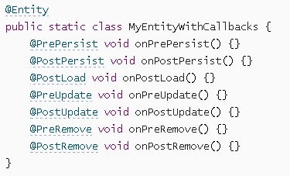
Lifecycle Events
Callback methods are user defined methods that are attached to entity lifecycle events and are invoked automatically by JPA when these events occur.
Internal Callback Methods-
Internal callback methods are methods that are defined within an entity class.

Slide 78
Internal callback methods should always return void and take no arguments. They can have any name and any access level (public, protected, package and private) but should not be static.
The annotation specifies when the callback method is invoked:
@PrePersist - before a new entity is persisted (added to the EntityManager).
@PostPersist - after storing a new entity in the database (during commit or flush).
@PostLoad - after an entity has been retrieved from the database.
@PreUpdate - when an entity is identified as modified by the EntityManager.
@PostUpdate - after updating an entity in the database (during commit or flush).
@PreRemove - when an entity is marked for removal in the EntityManager.
@PostRemove - after deleting an entity from the database (during commit or flush).
An entity class may include callback methods for any subset or combination of lifecycle events but no more than one callback method for the same event. However, the same method may be used for multiple callback events by marking it with more than one annotation.

Slide 79
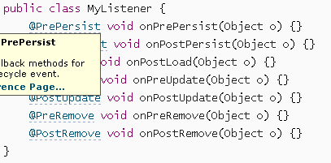

Listeners and External Callback Methods-
External callback methods are defined outside entity classes in a special listener class:
External callback methods (in a listener class) should always return void and take one argument that specifies the entity which is the source of the lifecycle event.
The listener class is attached to the entity class using the @EntityListeners annotation:

Slide 80


Multiple listener classes can also be attached to one entity class:
Listeners that are attached to an entity class are inherited by its subclasses unless the subclass excludes inheritance explicitly using the @ExcludeSuperclassListeners annotation:
Callback Invocation Order
If more than one callback method has to be invoked for a lifecycle event (e.g. from multiple listeners) the invocation order is based on the following rules:
All the external callback methods (which are defined in listeners) are invoked before the internal callback methods (which are defined in entity classes).
Default listeners are handled first, then listeners of the top level entity class, and then down the hierarchy until listeners of the actual entity class. If there is more than one default listener or more than one listener at the same level in the hierarchy, the invocation order follows the definition order.
Internal callback methods are invoked starting at the top level entity class and then down the hierarchy until the callback methods in the actual entity class are invoked.

Slide 81
Object Equality

Slide 82
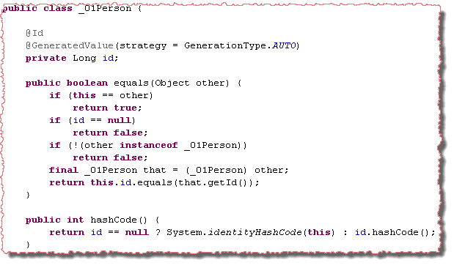
equals and hashCode methods with ID property
With respect to ORM, two POJO objects should be considered same object if they are pointing to the same database entity.
At first look, id property can be the best choice for the equals and hashcode method. But we will have a serious issue.
Id property is auto generated. For a transient object, we have a null value of id. If we save a transient object, id property is initialized. The hashcode method will return different hash code value for transient state and persistent state.
The hashcode method should return same hash code value for an object at different calls.

Slide 83
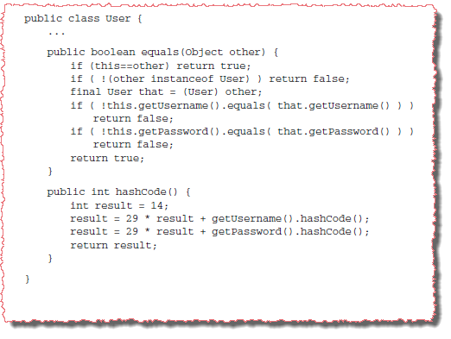
equals and hashCode method with all properties
A better way is to include all persistent properties of the persistent class, apart from any database identifier property, in the equals() comparison. This is how most people perceive the meaning of equals(); we call it by value equality.
However, there are again two problems with this approach:
Instances from different Sessions are no longer equal if one is modified (for example, if the user changes the password).
instances with different database identity (instances that represent different rows of the database table) can be considered equal unless some combination of properties is guaranteed to be unique (the database columns have a unique constraint).

Slide 84
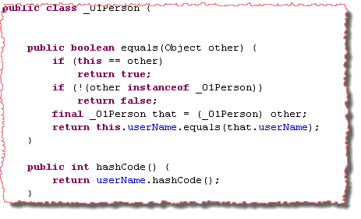
equals and hashCode With a Business Key
Business key equality means that the equals() method compares only the properties that form the business key. This is a perfect solution that avoids all the problems described earlier.

Slide 85
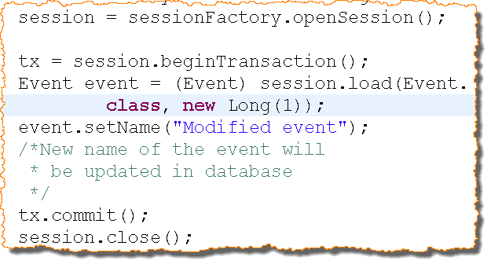
Automatic-dirty checking
It is the process of monitoring and updating only those persisted objects that have changed.
Hibernate monitors all Persistent objects (i.e. the objects in the persistent context). At the end of a unit of work, it knows which objects have been modified.
It then calls update statements on all modified objects.
Automatically dirty checking is performed before each commit
By default, only modified fields of an object is updated in database
It gives performance improvement

Slide 86
Exercise
Using the previous exercise, do the following -
Start a new entity manager and begin the transaction.
Get the author object using em.find() method .
Change the last name of the author object.
Commit the transaction without explicit call to save.
Confirm that the changed last name is persisted in the database.

Slide 87
Inheritance Mapping

Slide 88
Inheritance Mapping Challenges
Inheritance mapping is a challenge between the object-oriented and relational worlds because object-oriented systems support both is a and has a relationships where as SQL-based models provide only has a relationships between entities; SQL database management systems don’t support type inheritance.
Let us suppose that you are working with a payment gateway in an Online Shopping Application. A user can have more than one billing details. Payment can be done either by having a bank account or by credit card. Owner and creation date are the common fields in all kind of billing details. You would like to have below object model for your java code:

Slide 89
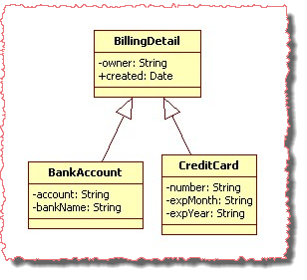
Object Level Inheritance Design
Problem Scenario - you are working with a payment gateway.
A user can have one or more Billing Details.
Payment can be done either by using your bank account(Net Banking) or by using a credit card.
Owner (payee’s name) and created(billing date) are the common fields in all kind of billing details. You would like to have below object model for your java code:
Notes:
We do allow the online shopping customer to have multiple BillingDetails. The various billing strategies are represented as subclasses of an abstract class (allowing future extension). For example, BankAccount and CreditCard are the child classes of BillingDetails.

Slide 90
How will you map object inheritance to database
???

Slide 91
Table Per Concrete Class (TPCC)

Slide 92
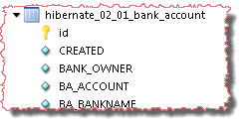
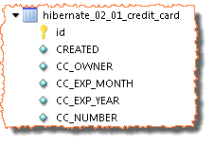
Table Per Concrete Class Inheritance Mapping
No Table Associated

Slide 93
TPCC Features
A table is created for a class that do not have any child class.
Table mapped to one concrete class have columns corresponding to the concrete class properties and parent class properties.
A class having child classes should not be a JPA entity.

Slide 94
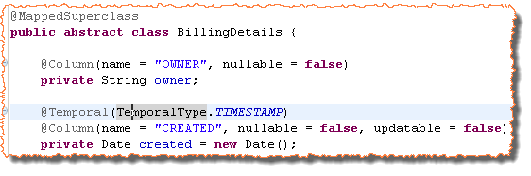
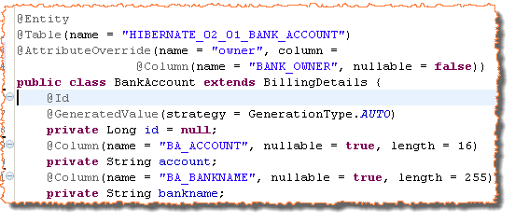
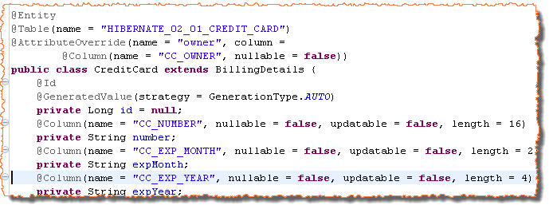
TPCC Example
Mapped Super Class
Not an Entity / No ID
Entity Class with ID
Override a column mapping

Slide 95
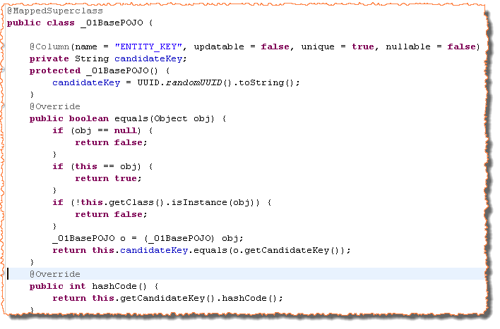
TPCC use case (Defining candidate key in base POJO)
Non updatable Candidate key
No Setter Method
Generate the key in constructor
Equals method comparing candidate key
Hash code method on candidate key

Slide 96
TPCC Problems
The main problem with this approach is that it doesn’t support polymorphic associations very well.
If you want to load a billing details with id 1, (Pass BillingDetail.class as a second argument in em.find() method), there may be a conflict in bank account and credit card. It is possible that a bank account exists in the database with primary key 1 and same for credit card.
You can not query on mapped super class in JPA (Possible in hibernate).
A further conceptual problem with this mapping strategy is that several different columns, of different tables, share exactly the same semantics. This makes schema evolution more complex. For example, a change to a superclass property results in changes to multiple columns.

Slide 97
Exercise
Create a class BookCategory, it has a property category code and publisher name.
Create a POJO class NewBookCategory. It inherits BookCategory and has a field discount rate
Create a POJO class OldBookCategory that extends BookCategory. It has a field discount amount
Create a POJO class RareBookCategory that extends BookCategory. It has a field extended price
Create an inheritance mapping by using table per concrete class approach.

Slide 98
Table Per Concrete Class with Union (TPCCU)

Slide 99
Table Per Concrete Class with Union
In table per concrete class (TPCC) approach, we could not query on the billing detail class as we can have a conflict in bank account (id=1) and credit card (id=1).
We will not have this issue if the set of bank account primary keys is different from the set of credit card primary keys (intersection results no element).
TPCCU approach makes sure that bank account table and credit table will not have same primary key. A Union of both tables is done to load an entity with the billing details class reference.
1
2
5
4
6
1
2
3
5
4
6

Slide 100
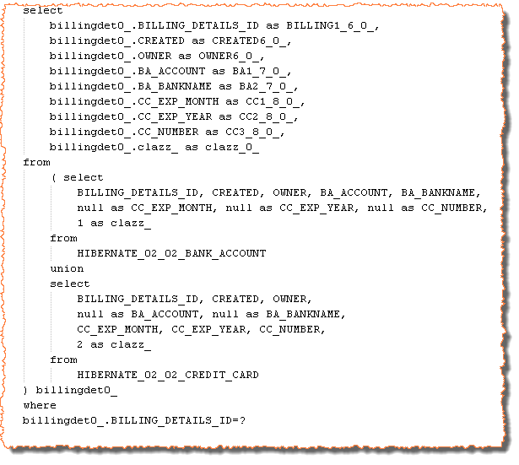
TPCCU Query
Union of two tables
Null column for credit card fields
Null column for bank account fields

Slide 101
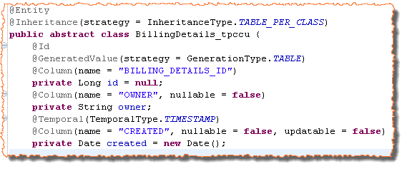


TPCCU Example
Entity with TABLE_PER_CLASS inheritance
ID in the parent class. ID Generation Strategy is TABLE
Entity without ID property

Slide 102
Exercise
Do the previous exercise by using table per concrete class with union approach.

Slide 103
Table Per Class Hierarchy (TPCH)

Slide 104

Table Per Concrete Class Inheritance Mapping
DISCRIMINATOR
Parent Class properties
Bank Account mapping
Credit Card mapping

Slide 105
TPCH Features
An entire class hierarchy is mapped to a single table. This table includes columns for all properties of all classes in the hierarchy.
The concrete subclass, represented by a particular row, is identified by the value of a type discriminator column (You need to map a discriminator column at class level).
For example, if the discriminator value is CC, row represents credit card and if the discriminator is BA, row represents bank account.
This mapping strategy is a winner in terms of both performance and simplicity. It’s the best-performing way to represent polymorphism—both polymorphic and non –polymorphic queries perform well

Slide 106



TPCCU Example
Entity with SINGLE_TABLE inheritance
ID in the parent class
Discriminator Settings
Default – DTYPE:String
Discriminator is BA
Discriminator is CC

Slide 107
TPCH Problems
You can not have not null constraints on any column. Credit card columns must be null if a row represents bank account.
Another important issue is normalization. We’ve created functional dependencies between nonkey columns, violating the third normal form.

Slide 108
Exercise
Do the previous exercise by using table per class hierarchy approach.

Slide 109
Table Per Subclass (TPS)

Slide 110



Table Per Subclass Inheritance Mapping
Parent Class properties
Bank Account mapping
Credit Card mapping
Bank Account table primary key references billing detail
Credit table primary key references billing detail

Slide 111
TPS Features
Every class/subclass that declares persistent properties—including abstract classes and even interfaces—has its own table.
If an instance of the CreditCard subclass is made persistent, the values of properties declared by the BillingDetails superclass are persisted to a new row of the BILLING_DETAILS table. Only the values of properties declared by the subclass are persisted to a new row of the CREDIT_CARD table.
The two rows are linked together by their shared primary key value. Later, the subclass instance may be retrieved from the database by joining the subclass table with the superclass table.

Slide 112


TPS Example
Entity with JOINED inheritance. Table mapping is required
ID in the parent class

Slide 113
Exercise
Implement the previous exercise using table per concrete class strategy

Slide 114
HQL And JPA QL

Slide 115
HQL/JPA QL Introduction
The Hibernate Query Language (HQL) is a full object-oriented query language. The Java Persistence query language (JPA QL) is a standardized subset of the Hibernate query language.
Using HQL or JPA QL, we write down database independent queries. Hibernate dialect (configured in hibernate.cfg.xml) is responsible to parse the standard HQL to the native database query, thus making our application Database Independent.
We use JPA QL queries in following ways-
Simple Queries: Return type is not defined
Typed Queries: Return type is defined (type safe)
Named Queries: Simple Queries defined in meta data

Slide 116

Simple Query Example
Entity name is used
Result of query is an object
No Type Safety
Each Person object is in persistence context

Slide 117

Typed Query Example
Entity name is used
Tell that Person is the type of result
Type Safety
Each Person object is in persistence context

Slide 118


Named Query Example
Name of the Query
No Type Safety
Query Defined in Metadata

Slide 119

Named Parameters
Setting parameter using named parameter.
Query Defined in Metadata

Slide 120
Pagination

Slide 121

Using JPAQL
Users may see the result of their search request as a page. For example user want to see 10 records of person entity starting from 5th record in the query result.
Below code snippets is an example of pagination:
Set the starting record
Set Maximum rows in result set

Slide 122
Query By Criteria

Slide 123

QBC JPA 2 Introduction
JPA didn’t support query by criteria before JPA 2. Since JPA 2, QBC API allows a query to be built by manipulation of criteria objects at runtime. This lets you specify constraints dynamically without direct string manipulations.
Boilerplate Code
Result type
A root type in the from clause.
What kind of value will be returned

Slide 124

Using Criteria Queries
Set the starting record
Set Maximum rows in result set

Slide 125

Restriction Using JPAQL with parameter Position binding
Parameter position binding
Set the parameter by position

Slide 126

Restriction Using JPAQL with parameter name binding
Parameter name binding
Set the parameter by name

Slide 127

Restriction Using Criteria Queries
Define a Predicate for where clause
Add the predicate to criteria query

Slide 128


More Restrictions
JPAQL
Criteria Queries

Slide 129

JPAQL Projection
Array of Objects is returned
JPAQL

Slide 130

JPAQL Aggregate Functions
JPAQL /HQL supports the following aggregate functions:
avg(…), sum(…), min(…), max(…)
count(*)
count(…), count(distinct…), count(all…)
For example, the following query counts all products:
Aggregate Functions
JPAQL

Slide 131


JPAQL Native SQL
Queries may be expressed in native SQL
Use when you need to use native SQL of the target database
Can call stored procedures using "call procname" syntax
Calling a Store proc Using Native SQL –
We can use createSQLQuery() to call a store procedure directly.

Slide 132


Scalar Queries :
The most basic SQL query is to get a list of scalars (values) from one or more tables. Following is the syntax for using native SQL for scalar values:
These will return a List of Object arrays (Object[]) with scalar values for each column in the _05Person table. Hibernate will use ResultSetMetadata to deduce the actual order and types of the returned scalar values.
To avoid the overhead of using ResultSetMetadata, or simply to be more explicit in what is returned, one can use addScalar():
This will return Object arrays, but now it will not use ResultSetMetadata but will instead explicitly get the id and name column as respectively a Long and String from the underlying resultset

Slide 133

Entity Queries :
The Scalar queries were all about returning scalar values, basically returning the "raw" values from the resultset. The following is the syntax to get entity objects as a whole from a native sql query via addEntity().

Slide 134
Exercise
Using the previous exercise, do the following –
Add multiple records to the table.
Try to fetch result using different queries.
Try to get result using Pagination.
Try Criteria Queries.
Try Projections, Aggregations and Native Queries.

Slide 135
Recap
JDBC Overview
Pros and Cons of JDBC
ORM Overview
Advantage of ORM
Hibernate Overview
Hibernate Architecture
Hibernate Configuration
Crud Operations
Hibernate components
Configuration
Session Factory
Session
Transaction
JPA Introduction
ORM Challenges
Persistence Lifecycle
Object Equality
Different Inheritance Mapping
HQL/JPA QL

Slide 136
References
http://www.tutorialspoint.com/hibernate/
https://docs.oracle.com/cd/E13224_01/wlw/docs103/guide/ormworkbench/hibernate-tutorial/tutHibernate1.html
http://javabeginnerstutorial.com/hibernate/hibernate-framework-basic/
https://docs.jboss.org/hibernate/orm/3.3/reference/en/html/tutorial.html

Slide 137
THANK YOU

